Slide 1


NIJANTHAN ELANGOVAN
19387033

Slide 2


ADVERTISING DURING COVID

Slide 3


CONTENTS
1.INTRODUCTION TO ADVERTISMENT DURING COVID-19
2.IMPROVISING BRAND VISIBILITY
3.STARTEGIES AND METHODS OF ADVERTISMENT
4.CONCLUSION
5.REFERENCE AND SOURCES

Slide 4

01
INTRODUCTION TO ADVERTISMENT DURING COVID-19

Slide 5

We are going through an unprecedented time, a ‘black swan’ event that has sent shock waves across the global economy – from large business houses to small next-door businesses, the COVID-19 pandemic has spared no one. Factories have been shut down, supply chains have been disrupted, marketing investments have been put on hold as countries are putting health and safety above everything else. Rightly so!
As the lockdown continues, we see second order effects leading to fundamental shifts in the consumer buying behaviour and media consumption. Consumer spending is seeing a spike on essentials, health & hygiene products; discretionary spends continue to tumble and planned purchases are being put on hold as saving cash has become a priority. As consumers avoid stepping outside, online shopping for groceries and medicines has seen tremendous growth, with orders of leading e-tailing platforms growing multiform even as the e-tailers continue to fix their supply chain issues.
Notes:
大专院校延期开学防疫工作安排

Slide 6

Likewise, the advertising space is seeing an explosive growth in digital content consumption (esp. on social media, OTT and gaming) and significantly increased TV viewership (40%+ over pre-Covid period), ironically coupled with advertising demand being subdued due to the current situation, except for select categories like essentials, health & hygiene.
Advertisers across industries have responded differently to the situation – while advertisements for essentials and health & hygiene products continue across media, most non-essential categories have restricted communications to digital, advertisers for categories under planned purchases have gone dark. Few companies are doubling down on brand building by highlighting their efforts towards combating the situation.

Slide 7
02
IMPROVISING BRAND VISIBILITY

Slide 8

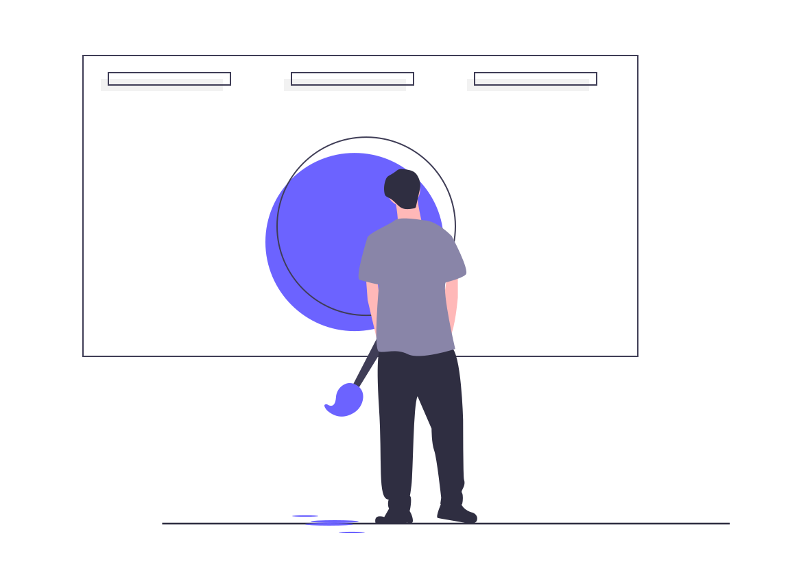


Ask consumers what they want
Innovate while staying true to your values
Continue to focus on video
Listen and communicate the right way

Slide 9
Ask consumers what they want
Think like your customer. What are they going through right now? What might they be worried about? Are there changes in the industry that they need to know about or might affect your products/services? Really question what your customer needs, wants and how they are currently interacting with your brand. You don't need to guess what your consumer wants either. Reformation, the women's clothing brand, asked their consumers what kind of content they wanted from the brand right now, and they gained first-hand knowledge and respect from their followers as a result. There are lots of ways brands can have similar dialogues with their customers to ensure they meet their expectations. Sending polls in newsletters, or posting them on social, blogs or even your homepage, can give brands the info they need without the guesswork

Slide 10
Continue to focus on video
Consider investing in video content now more than ever. According to Innovid's annual benchmark report of the state of video advertising, CTV impressions showed a YoY increase of 67%, personalized and creative ad formats drove the highest engagement, and 57% of ads were fifteen seconds long, proving to be the popular choice of marketers. This shows, it's not too late to jump right in with fresh or recycled video content. It could include tutorials, bite-sized snackable content, ads for TV, CTV, or digital, and so on. Weaving storytelling into your videos can help take them to the next level.
"The rapid growth we've seen in the OTT space means that video will play a significant role in marketing media plans, with marketers using the precision of digital to reach consumers on connected TVs and personal devices at scale."

Slide 11
Innovate while staying true to your values
How you approach today's challenges will define your role in consumers' lives after this crisis. Think creatively – focusing on your brand's main purpose and impact on society during the pandemic and post-pandemic should be a priority. Understand what new habits people are developing during this time and how they'll incorporate them into their future routines. Then, tap your creative team to develop solutions that can influence how your brand will tackle those imminent challenges. Above all, brands must stay genuine to the standards they're setting and live up to any statements and strategies made during and beyond the crisis.

Slide 12
Listen and communicate the right way
Are you communicating with your audience and know what they feel and need? Social listening and consumer sentiment tools can also help to know what they are feeling and talking about. These tools can help measure customer opinions and attitudes and provide some interesting insights. Once you know what your audience is talking about and what matters, reach out, and connect with them through email, social, and TV ads.
"With an onslaught of news and the biggest social disruption in generations, it's not surprising that consumer sentiment is constantly evolving around the COVID-19 pandemic. That's why it's very important for brands to lean into consumer sentiment tools. By understanding the topics and trends audiences are engaging with, brands can determine if, where and how they want to engage in the conversation."

Slide 13
03
STARTEGIES AND METHODS OF ADVERTISMENT

Slide 14

Prioritize brand building
Plan for FY21
Communicate right
Strategize for long term

Slide 15

Prioritize brand building
Increased TV and OTT viewership, reduced advertiser clutter and potentially lower rates due to lower demand, make for the perfect time to invest in brand building (rather than cutting spends). Monies earmarked for BTL can be redirected to deploy on media as consumer promos, offers, etc. are on a backburner. One way to execute brand building would be to explore higher ACDs (average commercial durations) with aspirational storytelling to drive salience.

Slide 16

Strategize for long term
Media strategy should be redefined to be in line with the inevitable disruptions in content consumption. Organizations should utilize this time to ramp up media knowledge across levels, with a special focus on digital, to enable better decision making – internal experts can engage the wider organization through webinars and digital workshops. This downtime can be effectively utilized to address long pending questions on beefing up digital –in terms of spends, effectiveness and capabilities.

Slide 17

Plan for FY21
With a constantly evolving situation and no clear timeline by which we will emerge out of the pandemic, brands need to engage in rigorous scenario-based planning assuming different timelines of recovery, changes in consumer behavior and modified budgets. Advertisers need to adopt a digital first approach as we adapt to a ‘new-normal’. To ensure opportunity and reality are balanced, media plans also need to be aligned with business strategy, such as timing of non-essentials demand returning to peak levels, investments in brand building on the back of cheaper inventories, allocation for bringing back the older imagery and recall levels, etc.

Slide 18

Communicate right
Advertisers need to ensure that messaging is appropriate and distinctive given the heightened sensitivity of consumers and focus on safety and care in most of the messaging. Communication should come across as informative and helpful and advertisers should be wary of being noticed as opportunistic and exploitative. Brand should re-align messaging around “new” core consumer values – safety, security, comfort and health. Additionally, with the advent of fake news and misinformation, it is of vital importance to ensure the brand image is not compromised by ads appearing across such content – use trusted channels on TV and extensive whitelisting and other brand safety measures on digital.

Slide 19
04
conclusion

Slide 20

conclusion
Marketing has always been a fast-moving field and many of us work from home so we’ve been able to adapt relatively quickly.Brands that go against the current norm and increase investments in brand-building will capture a disproportionate share of consumer mind-space. And most likely recover much faster once normalcy resumes.While we continue to analyze and understand the changing consumer behavior that the pandemic has brought about, it is impossible to know how it will shape up in the months to come. The best we as marketers and advertisers can do is to be present, communicate, and effectively modify campaigns as we go.

Slide 21
05
reference & sources

Slide 22

REFERENCE
01
Merilyn Pereira - https://marketing.toolbox.com/articles/4-strategies-to-improve-your-advertising-during-covid-19
02
Himanshu Bajaj ,Karan Dhall, Principal; Deepak Maloo, Principal and Suneesh Sappal, Manager, all from Kearney, also contributed to the article.
https://brandequity.economictimes.indiatimes.com/news/advertising/advertising-in-the-times-of-covid-19/75205422
03
Twitter,Medium,Wikipedia & Illustrations are from undraw.co

